Slide 1
Creating Places of Community & Care
Revd Gill Reeve (Chaplain)
University of Chester

Slide 2
Creating Places of Community & Care
Engaging Students
Community Hubs & Chaplaincy
Collaborative Projects & Shared Resources

Slide 3
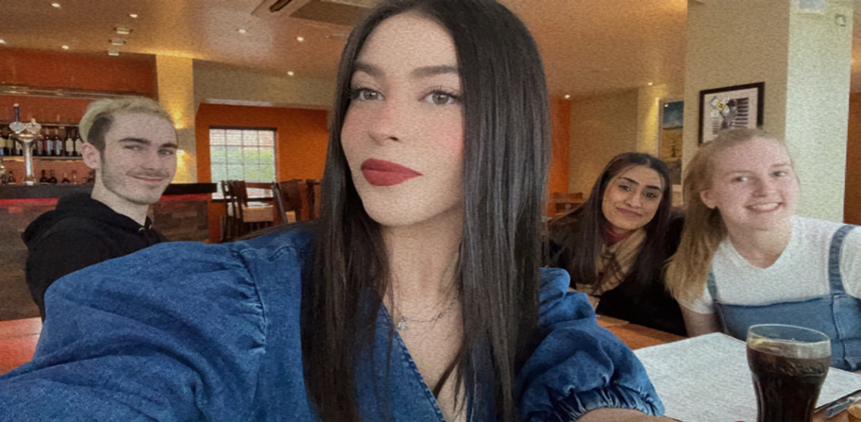
Student Voice:

Slide 4
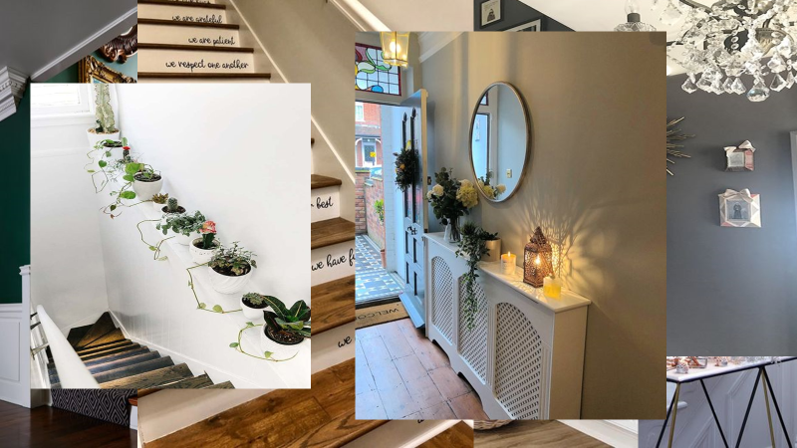
Community Hubs & Chaplaincy
Creative Space, Mindfulness Space, Games Room, Single Study Space
Community Kitchen, Community Garden

Slide 6
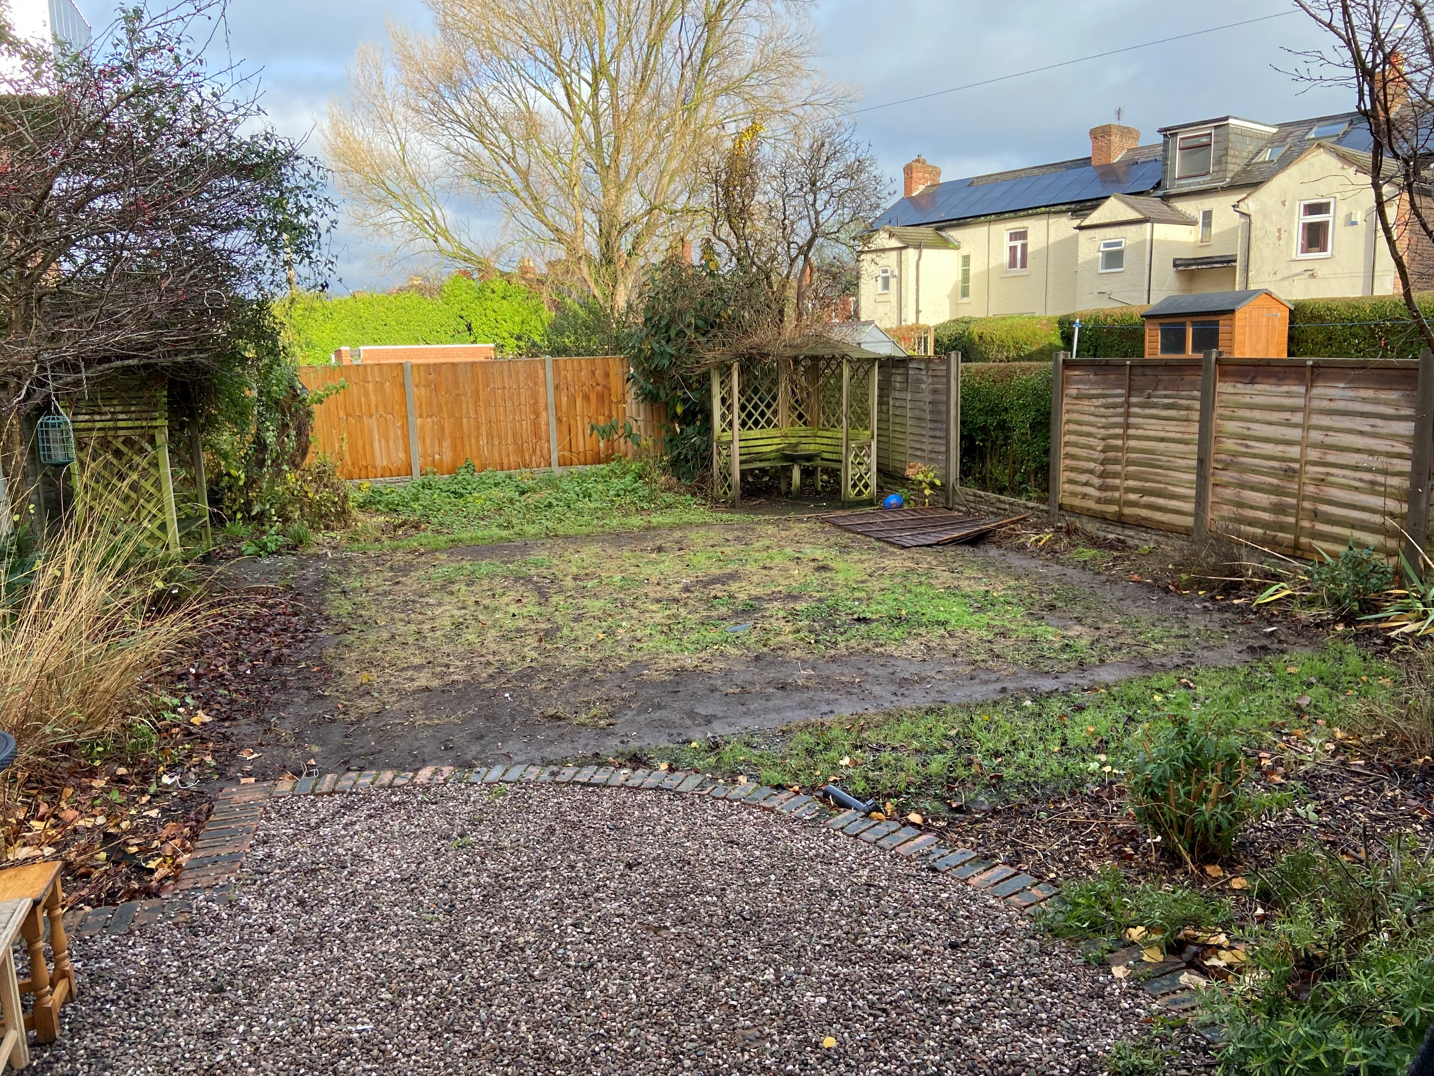
Collaborative Project: Community Garden
Chaplaincy
Student Sustainability Uni-job
Student Inter-faith Advocates
Sustainability Dept
Student Services Dept
Gardening Dept
Facilities & Estates Dept
Art Therapy Lecturer
Faiths4Change (environmental charity)

Slide 7
Collaborative Projects : Social Prescribing
Social Prescribing
Student Support Services
Chaplaincy
Faiths4Change
HEALTHBOX

Slide 8
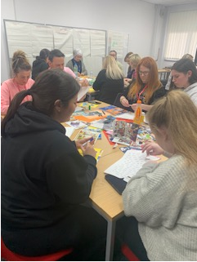
Collaborative Projects: Creative Health Placement
Wellbeing arts-based courses
Run by specialist art practitioners and our student nurses.
Open to the community, staff & students
Art, Music, Dance, Miniature Book Making
Drop-in café.

Slide 9
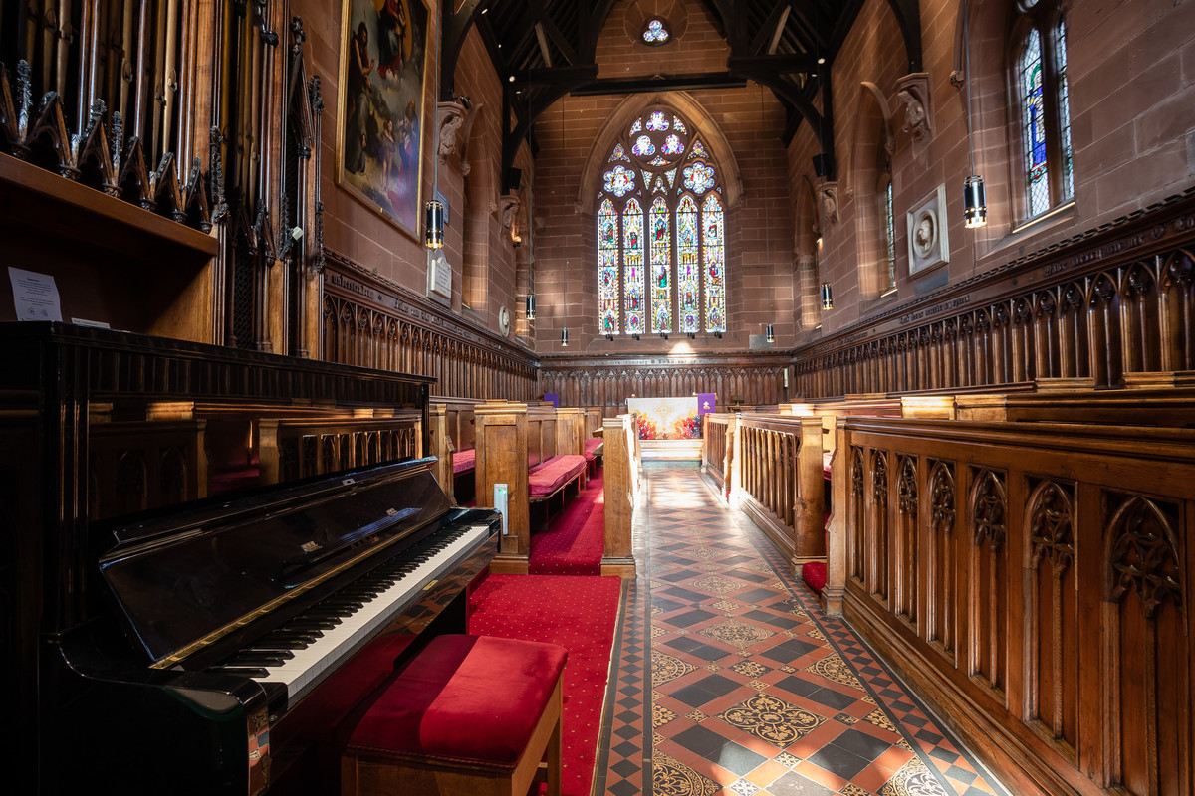
Ongoing questions I am wrestling with
How to re-shape Chapel to connect with work of the Community Hub?

