Slide 1
Service Learning-a proven model for whole person education
By
Nirmala Jeyaraj,
Former Principal, Lady Doak College,
Madurai, S. India

Slide 2
Story of S-L in Lady Doak College
For the first time in the college history, students were given opportunities to study abroad through Service Learning
LDC Students’-participation in International S-L-P-initiated & supported by CUAC & IPSL
Later LDC became the host to offer international-intercultural SLPs and over a decade or more, several student groups from 5 or more universities supported by United Board did S-L every year
International partnership with mutual student Exchanges for
SLP : ICU & LDC
A Model Intercultural S-L program hosted at LDC in partnership with ICU - MULTICULTURAL SYMBIOSIS THROUGH S-L.. A mega event..23rd July – 17th Aug 2007 (4 weeks)…24 students participated from 5 countries representing 6 universities

Slide 3
LDC Students-participation in International S-L P
Name | Host Inst. | Program | duration | sponsors
Selvameenakshi II B Com, Priscilla I M.Sc Zoo. | Trinity College, Quezon City Phiippines | Cross cultural SLP 8 countries participated) | June-Aug 1998 | IPSL & UB
L.Kirthiga III Botany | Whitelands College, London | SLP at Red ford Nursery | June- Aug. 1998 | CUAC
Annie Nirmala IIIBA Soc.Sci. | Renison College, Univ.of Waterloo, Canada | Cross cultural SLP 13 students from different countries | June-Aug 1999 | CUAC & IPSL
Evanjaline Samuel II BA History | Trinity College, Quezon City Philipines. | Cross cultural SLP | 6 weeks July-Aug 2001 | IPSL (Henry Luce Foundation)
Bala Pravina IIIB.A Soc.Sci | Trinity College, Quezon City Philipines. | Cross cultural SLP | 6 weeks, July -Aug 2002 | IPSL
Hannah Blessy II Phy. | Trinity College, Quezon City Philipines | Cross cultural SLP | 5 weeks, July-Aug. 2003 | IPSL
Notes:
Students from different countries engaging in service learning in a cross cultural context .Host institution offers the SL program –credit bearing and evaluative , Partially/ fully sponsored –resulting in long term impacts in personal life & career paths

Slide 4
II.International-intercultural SLPs hosted by LDC
Participants
Seoul Women’s Univ. Korea- 2 gps each yr from 2004
Chung Chi College, Chinese Univ.HK…2004 onwards
Poole Gakuin Univ.. Osaka,Japan…2004 onwards
Payap University, Thailand
International Christian University- 2003 onwards
Portland State University
Pacific University
Baptist University, HK
Silliman Univ., Dumaguete, Philippines- 2006

Slide 5
Student Exchanges (mutual ) for S-L
Partners with LDC for mutual exchange
-with credit transfer , expenses partially or fully met by sending inst.
International Christian University – 2003-04, 2006 (UB supported)
( 2 students each yr)
Akiko Sato & Hiroko Otsuka, the first exchange students on LDC campus for S-L from ICU
The first LDC students on ICU campus for S-L: Sathyasheela and Heeba Rani
- Returned with exciting & enriching experiences with obvious transformation of persons as better humans

Slide 6
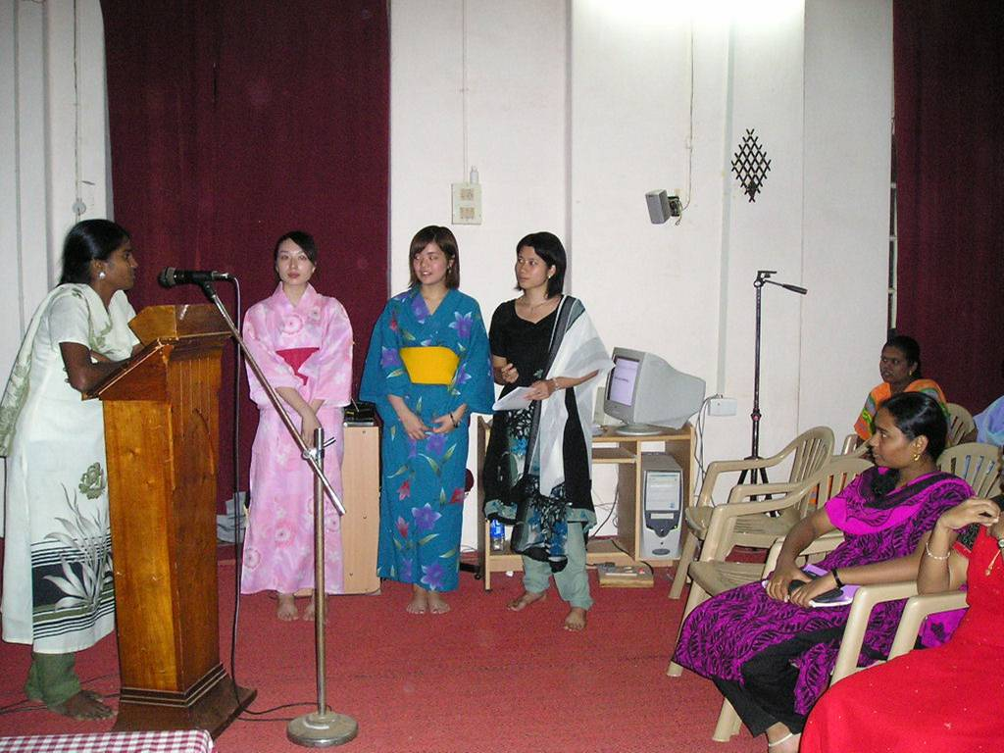
International Student
Exchange
Programme

Slide 7
Feed Back from Student participants in S-L
CUAC-1999 Service Learning Program held at Waterloo Canada*. “My experience in the classroom and on the field for two months helped me learn the scope of social work. I was so motivated by my experience in SLP that I was inspired to pursue my higher studies in social work. And as a licensed social worker, I was able to work as a crisis counselor for a short time. The experience I gained at SLP helped me deal with people with more compassion, especially the underprivileged. The experience also equipped me not to be overwhelmed or intimidated by the issues faced by people and communities, but to find resources to address those needs. Even after 24 years, I still cherish the experience I had at SLP Waterloo Canada. I’m so incredibly grateful for this experience. Thanks to CUAC for creating such rare opportunities for young students from around the world!”
Annie Nirmala, III Soc.Sci (1999)..personally communicated
Trinity College, Quezon City, Philippines…cross cultural interfaith S-L P
“We as participants from 8 different countries agreed with our differences and determined to love and live united under one roof “Service Learning. The heart of the program was our immersion into communities of underprivileged. We worked together and learnt from each other. Its the beginning of a transformed life”.
Selva Meenakshi, III B Com (1998)…extracts from College Magazine

Slide 8
Feed backs from participants of student exchange programme between ICU and LDC
“S-L is one great opportunity to transform a machine like man into a human being with all cherished values… S-L taught us to accept and appreciate people, their culture and traditions different from ours; learnt to understand and care for each other; learnt to adjust to new environment; broadened our world views; rekindled the spirit of social responsibility;
Janeera & Poornima III B Com (2005).. Extracts from College Magazine

Slide 9
Findings on effects of S-L
Students formation-positive effects on
personal Development – sense of personal efficacy, personal identity, spiritual growth, moral development
Interpersonal Development – ability to work well with others, leadership and communication skills
Sense of social responsibility and citizenship skills
Community understanding – cultural and racial
Commitment to service
Academic Learning – higher level learning
Career development - ability to apply in the real world
In a nutshell, S-L facilitates transformation of whole person involving Head, Heart and Habit

